Slide 1



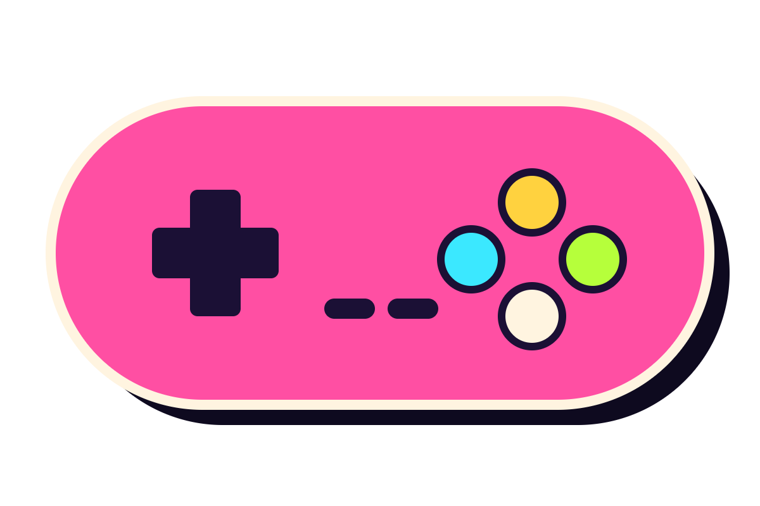
GIT GUD
+100 XP
PLAYER 1 - PRESS START
Git, GitHub & GitLab
for game devs
🎮 De Anza Game Dev Club
Notes:
Welcome everyone! Today we’re leveling up with the one tool every real game studio uses: Git. By the end you’ll know what Git, GitHub and GitLab are, and you’ll know how to push your own game online. Think of this as a 30-minute speedrun.

Slide 2
Hello, devs! 👋
LVL 0 > SPAWN
♥♥♥ 02/30
no boring lecture, promise 🤞
Today’s quest: learn the save system every real game studio uses, so you never lose your game again.
📍 you are here
01
02
03
04
What is Git?
GitHub & GitLab
Real commands
Push from IDE
Save points for your code
Online co-op servers for code
Terminal combos you’ll use daily
VS Code & friends, just buttons
Bring: a laptop + curiosity. Leave: with a repo online 🚀
Notes:
Here’s the quest map. Four checkpoints: what Git is, what GitHub and GitLab are, the real commands, and how to push straight from VS Code. If you get lost at any point, shout. There are no dumb questions in this club.

Slide 3



Meet your host 🎤
LVL 0 > HOST
♥♥♥ 03/30
scan me! 📱
Satkynov
Ilgiz
PLAYER 1
⚔️ CLASS: SWE
✨ SPECIAL MOVE: git push 🚀
💼 LinkedIn
🐙 GitHub
💀 WEAKNESS: merge conflicts at 3 am
🎯 Experience: AI Tutor (Grok), ex-SWE Intern (Microsoft)
linkedin.com/in/ilgizsatkynov
github.com/satkynovilgiz
let’s connect 🤝
follow for more commits 😎
Notes:
Hi, I’m Ilgiz Satkynov, and I’m your host today. Scan the QR codes to connect with me on LinkedIn and follow me on GitHub. By the end of today you’ll have your own GitHub too, so follow me back.

Slide 4

What even is Git?
loading… 💾
LEVEL 1
Git, GitHub, GitLab, and why your future self will thank you.
📚 lore time
Notes:
Level 1. Before any commands, let’s get the big picture: what Git is, what GitHub and GitLab are, and why anybody bothers.

Slide 5

Git = save points 💾
LVL 1 > GIT
♥♥♥ 05/30
Git is a free program that remembers every version of your project. Broke everything? Just load an old save.
RIP 🪦
SAVE 1
SAVE 2
SAVE 3
LOAD 2
Added the player 🧍
Added double jump 🦘
Broke EVERYTHING 💀
Back in business ✨
Mon, 4:02 pm
Tue, 9:15 pm
Wed, 2:47 am
took 0.5 seconds
🐧 Made in 2005 by Linus Torvalds (the Linux guy)
📴 Runs on your laptop, even offline
💸 Free & open source
Notes:
Best way to think about Git: it’s a save system for your code. Every time you “commit”, you make a save point. At 2:47 am when you break everything, you just load the last good save. No more copying folders around.

Slide 6
Speak Git like a gamer
LVL 1 > GIT
♥♥♥ 06/30
basically a cheat menu 🕹
IN GAMES
IN GIT
TYPE THIS
💾 Save the game
commit
git commit
📜 Your list of saves
log (history)
git log --oneline
⏪ Load an old save
checkout
git checkout a1b2c3d
🌌 Parallel timeline
branch
git switch -c new-idea
🔀 Merge two timelines
merge
git merge new-idea
🌐 Online co-op server
remote
git push / git pull
📖 vocab unlocked
Notes:
Git has its own vocabulary, but every word maps to something you already know from games. Commit is saving. Log is your list of saves. Branch is a parallel timeline. Merge combines timelines. A remote is the online server, like GitHub.

Slide 7

How a save happens
LVL 1 > GIT
♥♥♥ 07/30
the ONE slide to remember 🧠
Every save travels through 3 zones on your laptop, then 1 online.
🛠
🎒
🏰
☁️
git add
git commit
git push
Working folder
Staging area
Local repo
GitHub / GitLab
Where you edit code & art
Packing your backpack for the save
Saved forever on your laptop
Backed up online for the team
💡 add = pick what goes in the save · commit = press SAVE · push = upload to the cloud
Notes:
This is the one diagram to remember. You edit files in your working folder. git add puts the changes you want into the staging area, like packing a backpack. git commit makes the actual save. git push uploads your saves to GitHub or GitLab so the team can see them.

Slide 8

What is GitHub? 🐙
LVL 1 > GITHUB
♥♥♥ 08/30
since 2008 · owned by Microsoft
Git is the console. GitHub is the online multiplayer server where your code lives.
☁️ Repos
🤝 Pull Requests
🐛 Issues
Your project + every save, safe in the cloud
Teammates review code before it joins the game
A shared to-do list for bugs & features
🤖 Actions
🌟 Portfolio
🎓 Student Pack
Robots that test & build your game on every push
Your profile shows recruiters what you’ve built
Free pro tools when you verify as a student
recruiters lurk here 👀
Notes:
Big confusion point: Git and GitHub are not the same thing. Git is the program on your laptop. GitHub is a website that hosts Git projects online, plus tools for teams: pull requests, issues, and Actions. Bonus: the GitHub Student Developer Pack gives you free pro tools once you verify you’re a student.

Slide 9
What is GitLab?
LVL 1 > GITLAB
♥♥♥ 09/30
GitHub’s cousin 👯
Same Git, different server. GitLab is an all-in-one DevOps platform: code, pipelines, planning.
🔀 Merge Requests
⚙️ CI/CD built in
🏠 Self-host it
GitLab’s name for Pull Requests. Same idea.
Add a .gitlab-ci.yml and it builds on every push
Run your own GitLab server with the free edition
📋 Boards
🔓 Open core
🏢 Who uses it
Plan sprints like a mini game studio
The Community Edition is open source
Companies & schools that want full control
🦝 tanuki gang
Notes:
GitLab does the same core job as GitHub: hosting Git projects online. Its big thing is being all-in-one, with CI/CD pipelines built right in, and you can run it on your own server. On GitLab, pull requests are called merge requests. Same thing.

Slide 10
Why even bother?
LVL 1 > WHY
♥♥♥ 10/30
fr fr 💯
💥
⏪
👯
Laptop died?
Infinite undo
Real teamwork
Your game is safe online. Clone it and keep going.
Jump back to any save, any time. Ctrl+Z on steroids.
4 people, 1 project, zero zip files sent on Discord.
🔍
🧪
💼
Who broke it?
Try wild ideas
Get hired
See exactly who changed what line. (git blame 👀)
Experiment on a branch. Hated it? Delete it.
Studios use Git daily. It shows up on tons of job posts.
Notes:
Six reasons. The big ones for us: your game survives a dead laptop, you get infinite undo, and a team can work on one project without sending zip files around Discord. Plus, knowing Git is expected at basically every internship.

Slide 11
Life without Git 😱
LVL 1 > WHY
♥♥♥ 11/30
WITHOUT GIT
WITH GIT
📦 MyGame_final.zip
$ git log --oneline
📦 MyGame_final_v2.zip
3f9a2c1 Add double jump
📦 MyGame_FINAL_final.zip
a1b2c3d Fix enemy walking into walls
📦 MyGame_FINAL_REAL_use_this.zip
9e8d7c6 Add main menu music
📦 MyGame_(Jake's laptop).zip
5b4a3f2 Add player movement
📦 MyGame_pls_work.zip
0c1d2e3 Initial commit
📦 MyGame_pls_work(1).zip
# one folder. every version. 🧘
which one is real?? 😵‍💫
one folder, zero stress 😌
Notes:
Be honest, who has a folder that looks like the left side? We’ve all been there. With Git you keep one folder, and every version lives in its history with a message saying what changed.

Slide 12
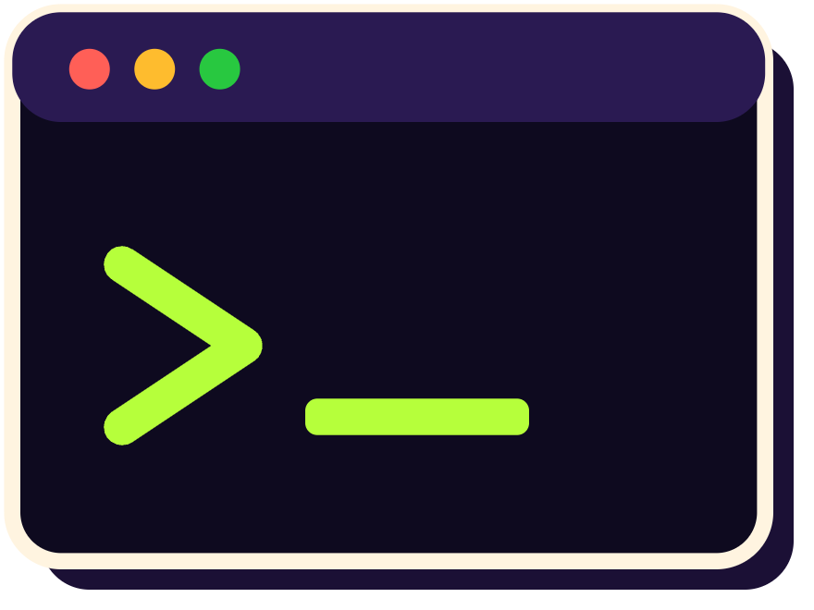
Real coding time
hacker mode 😎
LEVEL 2
Open a terminal. Crack your knuckles. Let’s go.
⚠️ real code ahead
Notes:
Level 2. Now we actually type stuff. Everything from here is real commands you can copy. If you have a laptop, follow along.

Slide 13
Boss prep: setup
LVL 2 > SETUP
♥♥♥ 13/30
⏱ 2-minute setup
STEP 1
bash — do this once
Install Git
# 1. Tell Git who you are
git-scm.com
$ git config --global user.name "Your Name"
$ git config --global user.email "you@example.com"
STEP 2
Make a free account
# 2. Turn your game folder into a repo
github.com or gitlab.com
$ cd MyAwesomeGame
$ git init
STEP 3
Initialized empty Git repository in
Check it works
~/MyAwesomeGame/.git/ ✅
git --version
Notes:
One-time setup. Install Git from git-scm.com, make a free GitHub or GitLab account, and check it works with git --version. Then tell Git your name and email, which get stamped on every save. git init turns any folder into a Git repo.

Slide 14
The daily combo 🔥
LVL 2 > COMBO
♥♥♥ 14/30
📌 your whole daily routine
git add
git commit
git push
+
+
=
💾 SAVED ONLINE
pick the files
press SAVE
upload it
bash — space-goose
COMBO x3!
$ git status
modified: Assets/Scripts/PlayerController.cs
$ git add .
$ git commit -m "Add double jump"
[main 3f9a2c1] Add double jump · 1 file changed, 12 insertions(+)
$ git push
To github.com:deanza-gamedev/space-goose.git
a1b2c3d..3f9a2c1 main -> main 🚀
Notes:
This is 90 percent of what you’ll do every day. git status shows what changed. git add picks the files. git commit with a message saves. git push uploads. Write messages like patch notes: “Add double jump,” not “stuff.”

Slide 15
Join a team project
LVL 2 > CO-OP
♥♥♥ 15/30
🤝 co-op mode ON
bash
📥 clone
# day 1: download the whole project
Download the project + every save. Do it once.
$ git clone https://github.com/deanza-gamedev/space-goose.git
Cloning into 'space-goose'... done.
$ cd space-goose
🔄 pull
# every day after: get teammates’ saves
Grab your teammates’ newest saves. Do it daily.
$ git pull
Updating 3f9a2c1..7e8f9a0 · Fast-forward
3 files changed, 87 insertions(+) 🎉
GOLDEN RULE
PULL before you work. PUSH when you’re done. ✨
Notes:
To join an existing project, you clone it once. That downloads the code and its full history. Then every day before you start, git pull to grab whatever your teammates pushed. Golden rule: pull before you work, push when you’re done. It prevents most merge conflicts.

Slide 16
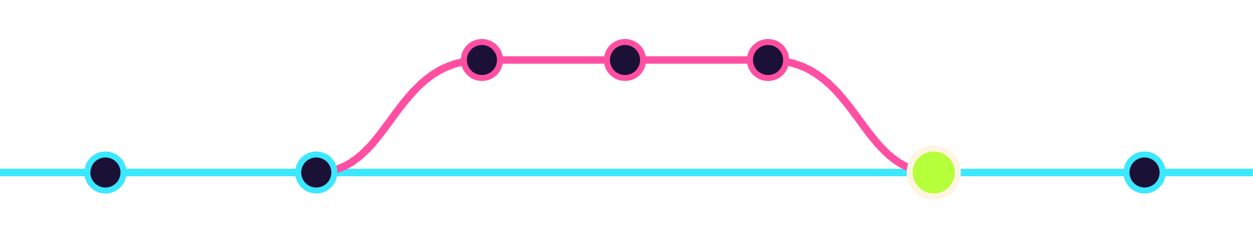
Branches: parallel worlds 🌌
LVL 2 > BRANCH
♥♥♥ 16/30
feature/double-jump
new idea, safe sandbox 🧪
main
main stays playable the whole time 🎮
merge! 🎉
bash
$ git switch -c feature/double-jump # open a new universe
delete if it sucks 🗑
$ git commit -am "Double jump works!" # save inside it
$ git switch main # go home
$ git merge feature/double-jump # bring it in 🎉
Notes:
A branch is a parallel universe of your project. You can go wild adding double jump on a branch while main stays playable. When it works, you merge it back. If it’s a disaster, delete the branch and nobody ever knows.

Slide 17
Boss fight: merge conflict ⚔️
LVL 2 > BOSS
♥♡♡ 17/30
PlayerController.cs ⚠️
HOW TO WIN
Don’t panic. It’s normal.
Keep the right line (or both)
Delete the <<< === >>> markers
git add . then git commit
Talk to your teammate 🤝
Accept Current | Accept Incoming | Accept Both | Compare
<<<<<<< HEAD (your change)
float jumpForce = 10f;
=======
float jumpForce = 9000f; // trust me bro
>>>>>>> feature/super-jump (theirs)
Happens when two people change the same line differently. Git can’t guess who’s right, so it asks you.
it’s not a bug, it’s a boss 😤
Notes:
Merge conflicts sound scary but they’re just Git asking a question. Two people edited the same line. Git marks both versions. You keep the one you want, or combine them, delete the marker lines, then add and commit. VS Code even gives you Accept buttons right above the conflict.

Slide 18
Don’t upload the junk 🗑
LVL 2 > LOOT
♥♥♥ 18/30
Library/ = GBs of nope 🙅
A .gitignore file lists stuff Git should skip, like Unity’s giant auto-generated Library folder.
.gitignore · Unity
.gitignore · Godot 4
# Unity rebuilds these itself
# Godot’s cache folder
[Ll]ibrary/
.godot/
[Tt]emp/
# your exported builds
[Oo]bj/
builds/
[Bb]uild/
[Bb]uilds/
[Ll]ogs/
🎁 Free templates
[Uu]ser[Ss]ettings/
Pick one when you create a repo on GitHub, or grab it from
# IDE files
*.csproj
github.com/github/gitignore
*.sln
Notes:
Game engines generate tons of cache files. Unity’s Library folder alone can be gigabytes, and Unity rebuilds it automatically. A .gitignore tells Git to skip those. Add one before your first commit. GitHub has ready-made templates for Unity and Godot.

Slide 19

Push from your IDE
click click 🖱
LEVEL 3
Scared of the terminal? Fair. VS Code has buttons for all of it.
👆 no terminal needed
Notes:
Level 3. Everything we just typed, VS Code can do with buttons. Under the hood it runs the exact same Git commands.

Slide 20





VS Code: stage & commit
LVL 3 > VS CODE
♥♥♥ 20/30
✨ button gang
space-goose — Visual Studio Code
1
Open Source Control
SOURCE CONTROL
PlayerController.cs
Branch icon, or Ctrl+Shift+G
3
Add double jump 🦘
void Update() {
if (Jump() && jumpsLeft > 0) {
2
Stage files
4
✓ Commit
rb.velocity = up * jumpForce;
Hover a file, click + (that’s git add)
▾ Staged Changes (1)
jumpsLeft--;
1
}
PlayerController.cs
M
}
3
Write a message
▾ Changes (1)
// 🦘 boing boing
Like a patch note: what changed?
2
EnemyAI.cs
+
U
4
Click ✓ Commit
⑂ main*
⟳ 0↓ 1↑
or Ctrl+Enter (Mac: ⌘+Enter)
Notes:
Here’s the VS Code version of add and commit. Click the Source Control icon, the one that looks like a branch. Hover a file and click the plus to stage it. Type your message in the box, then hit Commit. That’s literally git add plus git commit.

Slide 21
VS Code: push it online
LVL 3 > VS CODE
♥♥♥ 21/30
☁️ to the cloud!
space-goose — Visual Studio Code
1
Publish Branch
SOURCE CONTROL
First push of a new repo
space-goose
1
☁ Publish Branch
2
Publish to GitHub private repository
2
Private or public
No changes. Saved locally ✅
Publish to GitHub public repository
Sign in to GitHub, click Allow
After the first push:
void Update() {
3
⟳ Sync Changes 1↑
if (Jump() && jumpsLeft > 0) {
3
Sync Changes
rb.velocity = up * jumpForce;
Then: pull + push in one click
⑂ main
☁ publishing…
🧡 On GitLab?
Make an empty project on gitlab.com, copy its URL, then:
git remote add origin <url>
git push -u origin main
Notes:
To get it online: click Publish Branch. VS Code asks if you want a private or public GitHub repo, then pops open your browser to sign in. Click Allow, done, your game is on GitHub. After that, the button turns into Sync Changes, which pulls and pushes in one click. For GitLab, create an empty project on the website and point your repo at it with git remote add, then push once.

Slide 22
Not a VS Code main?
LVL 3 > OTHER IDES
♥♥♥ 22/30
🎮 pick your class
🟣 Visual Studio
🧠 JetBrains Rider
Popular for Unity + C#
Two shortcuts, that’s it (Mac: ⌘ instead of Ctrl)
Git Changes
→
message
→
Commit All
→
↑ Push
Ctrl+K
commit
·
Ctrl+Shift+K
push
🤖 Godot
🖥 GitHub Desktop
No big Git button built in. Pick one:
Zero typing. Works with GitLab repos too.
terminal combo
or
GitHub Desktop
or
Commit to main
→
Push origin
Godot Git plugin
Every button runs the same add → commit → push under the hood. Same game, different controller. 🎮
Notes:
Not everyone uses VS Code. In Visual Studio, open the Git Changes window, type a message, Commit All, then push. In Rider it’s Ctrl+K to commit and Ctrl+Shift+K to push. Godot folks can use the terminal, GitHub Desktop, or the official Godot Git plugin. GitHub Desktop is the easiest app if you never want to type a command.

Slide 23

Team mode
almost there 🏁
LEVEL 4 · FINAL BOSS
Pull requests, GitHub vs GitLab, and pro tips for game repos.
😤 boss music starts
Notes:
Final level: how teams actually work together with pull requests, the GitHub versus GitLab showdown, and some pro tips specifically for game projects.

Slide 24

Pull Request = Merge Request
LVL 4 > CO-OP
♥♥♥ 24/30
Same thing, different name. GitHub says PR, GitLab says MR. It’s how teams ask “can I add this?”
🌱
💾
⬆️
📬
👀
🎉
Branch
Commit
Push
Open PR/MR
Review
Merge
🐸
[teammate] reviewed PlayerController.cs
Nice jump!! 🔥 but pls delete Debug.Log("AAAAAAAAA") before we merge 😭
✅ Approve
🔁 Request changes
💬 Comment
LGTM 👍 (didn’t read it)
Notes:
This is how real teams work. Make a branch, commit, push it, then open a pull request on GitHub, or a merge request on GitLab. A teammate reviews the code, leaves comments, and approves. Then it gets merged into main. Reviews catch bugs, and embarrassing debug logs.

Slide 25
GitHub vs GitLab
LVL 4 > VERSUS
♥♥♥ 25/30
spoiler: it’s a tie 🤝
Round | GitHub 🐙 | GitLab 🧡
Vibe | Huge community + open source hub | All-in-one DevOps platform
Code review | Pull Requests (PR) | Merge Requests (MR)
Automation | GitHub Actions | GitLab CI/CD, built in
Host it yourself | Enterprise Server (paid) | Free Community Edition
Owned by | Microsoft | GitLab Inc.
Free private repos | Yes | Yes
Best for us | Portfolios, open source, game jams | Teams wanting their own server
🤝 Both run on Git. Learn the commands once, use them on either.
Notes:
Head to head: GitHub is the biggest community and where most open source and portfolios live. GitLab is the all-in-one platform with CI/CD built in, and you can self-host the free Community Edition. For our club, GitHub is usually easiest for portfolios and game jams. But both run on Git, so everything you learned today works on either.

Slide 26
Pro tips for game repos
LVL 4 > PRO TIPS
♥♥♥ 26/30
🐘
🍰
📝
Git LFS for big files
Commit small & often
Messages = patch notes
PSDs, WAVs, 3D models go in Large File Storage
One feature per save. Way easier to undo one thing.
“Fix enemy spawning in walls”, not “stuff”
git lfs track "*.psd"
🔑
🎬
🔄
Never commit secrets
One scene, one person
Pull before you push
API keys & passwords stay out. Bots scan public repos.
Scene files merge badly. Split work into prefabs.
Dodges most merge conflicts before they spawn.
Notes:
Game repos have special problems. Big art and audio files should go in Git LFS. Commit small and often. Write messages like patch notes. Never commit passwords or API keys, because bots scan public repos for them. And in Unity, two people editing the same scene file is pain, so split work into prefabs or separate scenes.

Slide 27
Commit message tier list
LVL 4 > HALL
♥♥♥ 27/30
F TIER 🤡
S TIER 🏆
fixed stuff
Add coyote time to jump
we’ve all been there 😔
asdfghjkl
Fix enemies spawning in walls
pls work
Lower boss HP from 500 to 350
final fix (not final)
Add pause menu + volume slider
i hate unity
Remove debug logs before demo
AAAAAAAAAAAA
Speed up level 2 loading
FORMULA
Verb + what changed. Write it like a patch note your players would read.
Notes:
Quick tier list. Left side: commit messages we have all written at 3 am. Right side: messages your teammates, and future you, will actually understand. Formula: start with a verb, say what changed.

Slide 28
Cheat codes 🕹
LVL 4 > CHEATS
♥♥♥ 28/30
📸 screenshot this one
git init
git clone <url>
git status
start a new repo
download a project
what changed?
git add .
git commit -m "msg"
git push
stage everything
SAVE with a name
upload your saves
git pull
git log --oneline
git switch -c name
get teammates’ saves
your save history
new branch
git merge name
git restore file
git stash
combine branches
undo unsaved edits
hide edits for later
Notes:
Here are the twelve commands that cover almost everything you’ll do. Tell everyone to screenshot this slide. If you only remember four: status, add, commit, push.

Slide 29


GG! Questions?
QUEST LOG
♥♥♥ 29/30
Side quest unlocked!
Install Git
Make a GitHub or GitLab account
Push any project (yes, even Pong)
Drop your repo link in [club Discord channel]
🎁 Reward: +500 XP & eternal bragging rights
due: next meeting ⏰
Notes:
Homework, but fun: install Git, make an account, push any project, even a Pong clone, and post the link in the club Discord. Everyone who does it gets bragging rights. Then open it up for questions. GG everyone!

Slide 30

♥♥♥ 30/30
Notes:
Last slide. Play the hamster video, either click the link or let people scan the QR code. Then thank everyone for coming. GG!

